Slide 1

Why I Was Wrong About TypeScript
TJ VanToll

Slide 2


Slide 3

13-year-old me
Boom

Slide 4
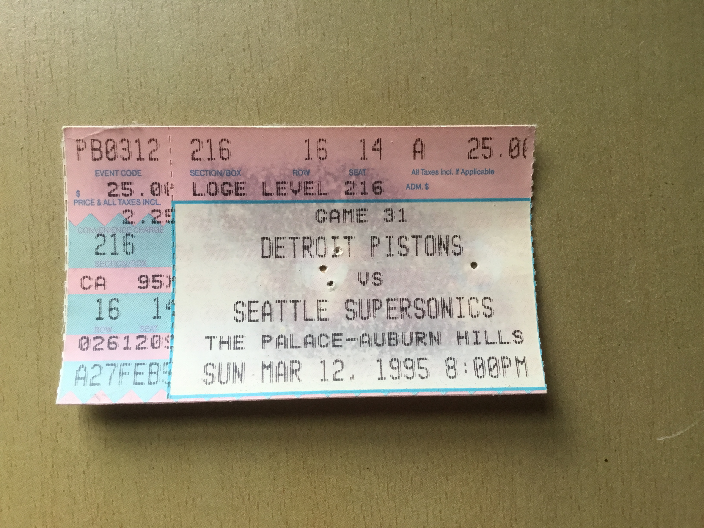

Slide 5
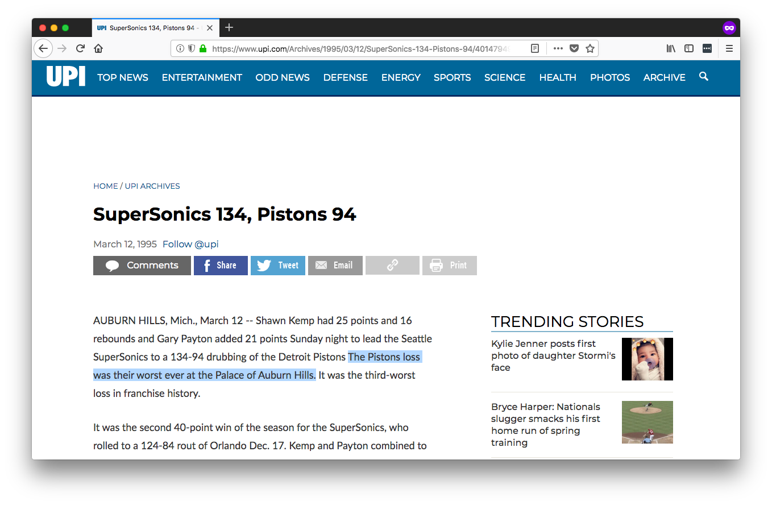
😮

Slide 6
TypeScript

Slide 7
TypeScript
Triple-Slash Directives
Declaration files
Namespaces
Structural detection
Classes
Compiler options
Type Inference
Modules
Generators
Declaration merging
Decorators
Generics
Mixins
Sequential piping
Symbols

Slide 8
TypeScript
Triple-Slash Directives
Declaration files
Namespaces
Structural detection
Classes
Compiler options
Type Inference
Modules
Generators
Declaration merging
Decorators
Generics
Mixins
Sequential piping
Symbols

Slide 9
Why I Was Wrong About TypeScript

Slide 10
Whether TypeScript is a good fit for your next project

Slide 11
Why I Was Wrong About TypeScript

Slide 12
“A typed superset of JavaScript that compiles to plain JavaScript”

Slide 13
“A typed superset of JavaScript that compiles to plain JavaScript”

Slide 14


Slide 15
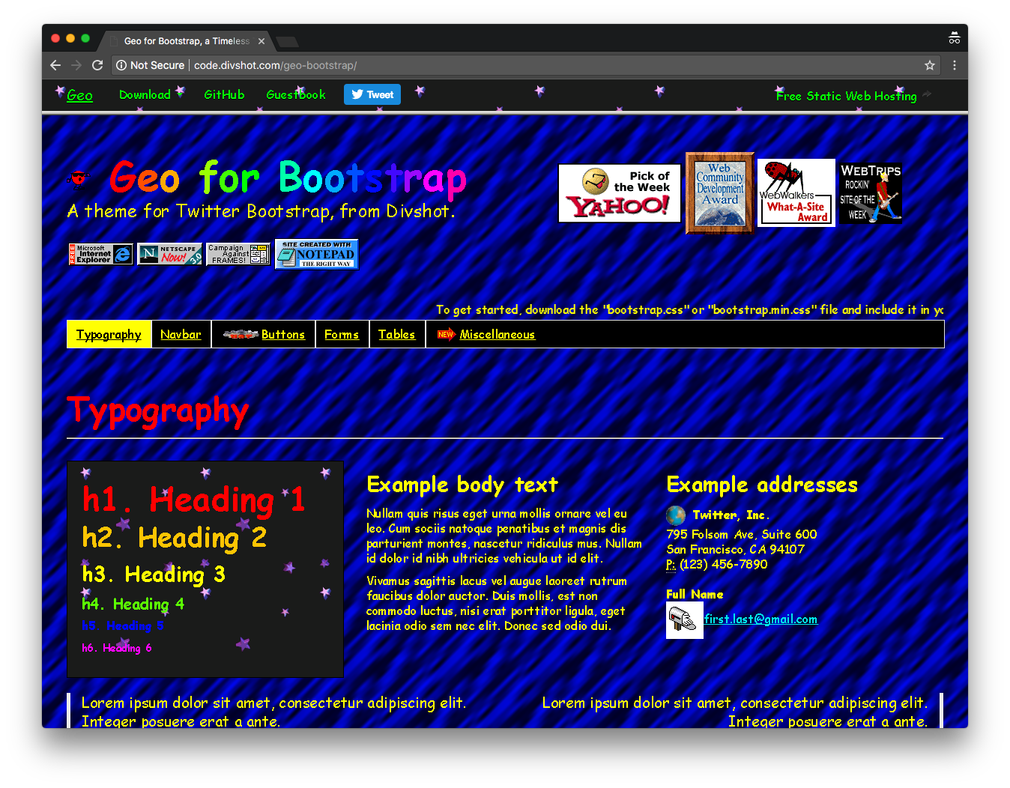

Slide 16
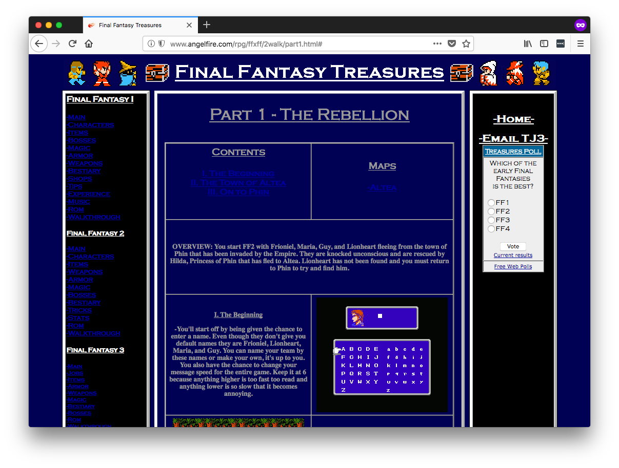
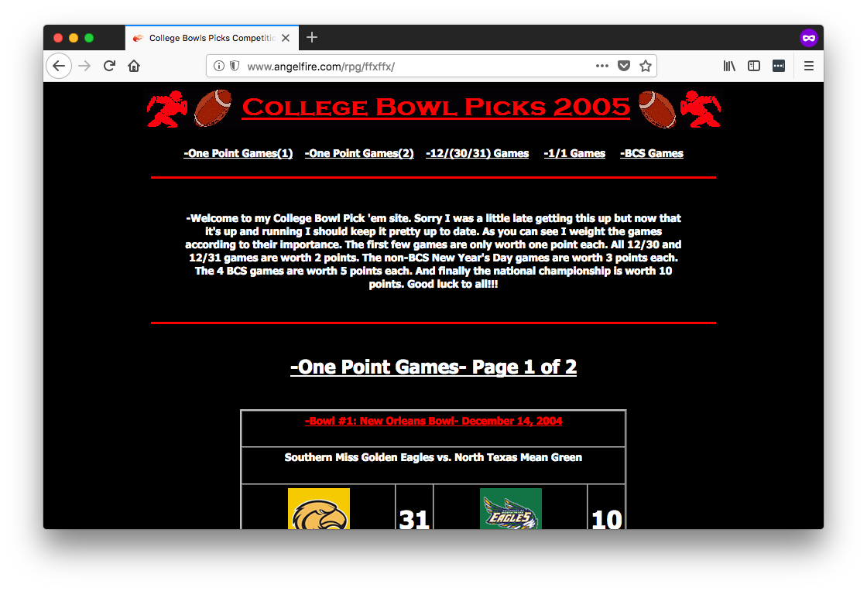
Actual web sites I built.

Slide 17
👨‍💼👩‍💼

Slide 18
😍

Slide 19
😠

Slide 20
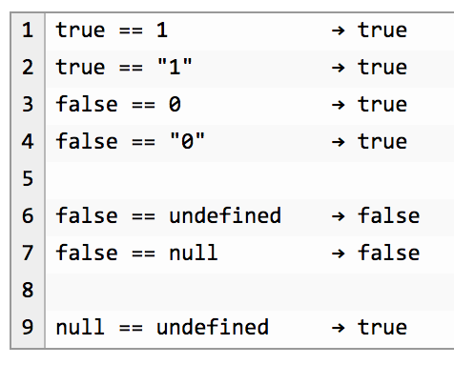

Slide 21
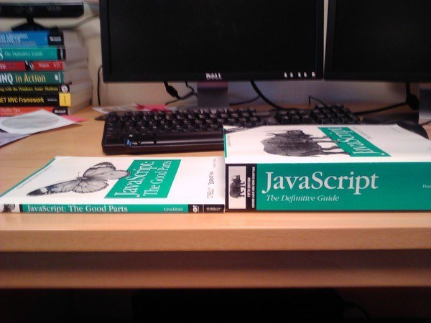
Notes:
34

Slide 22
Compile to JavaScript tools
There are a lot.
345
Source: https://github.com/jashkenas/coffeescript/wiki/List-of-languages-that-compile-to-JS
Ruby, Python, Erlang, Java, Scala, C#, F#, Lisp, Scheme, Haskell, Smalltalk, C, C++, Basic, Go, PHP, and way more.

Slide 23
Fun names of compile-to-JS tools
treehugger
jangaroo
Waterbear

Slide 24
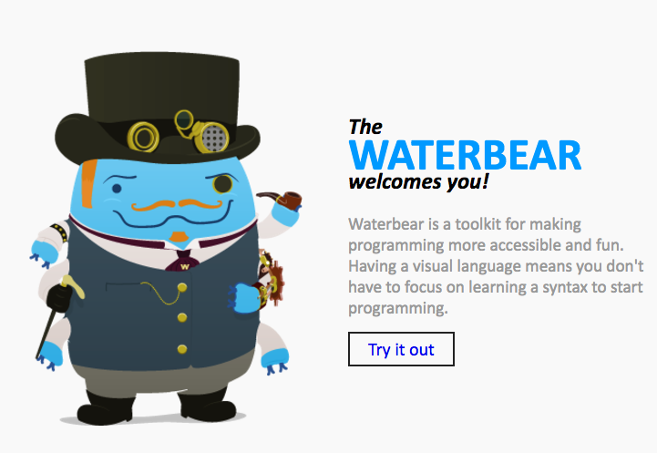
http://waterbearlang.com/

Slide 25
Compile to JavaScript tools
There are a lot.
345
Source: https://github.com/jashkenas/coffeescript/wiki/List-of-languages-that-compile-to-JS
Ruby, Python, Erlang, Java, Scala, C#, F#, Lisp, Scheme, Haskell, Smalltalk, C, C++, Basic, Go, PHP, and way more.

Slide 26
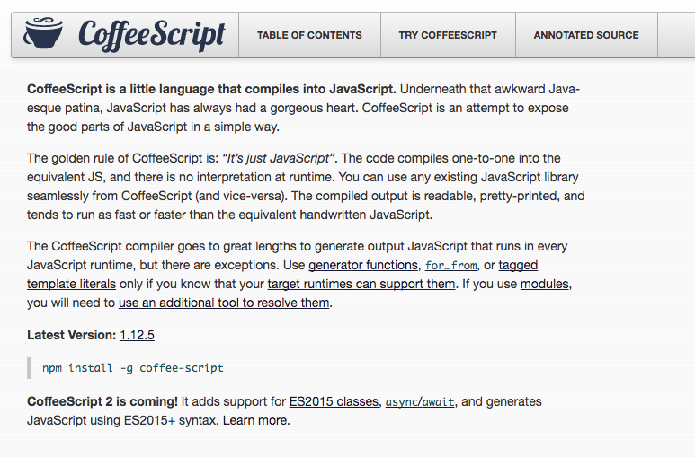
Notes:
2009

Slide 27
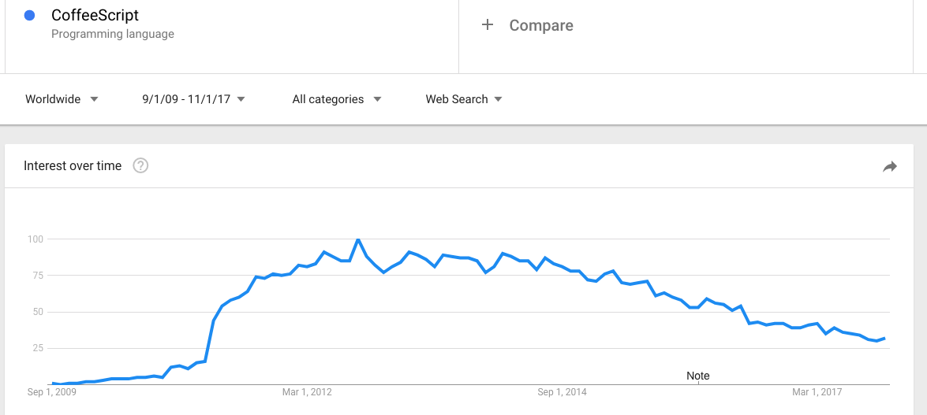

Slide 28
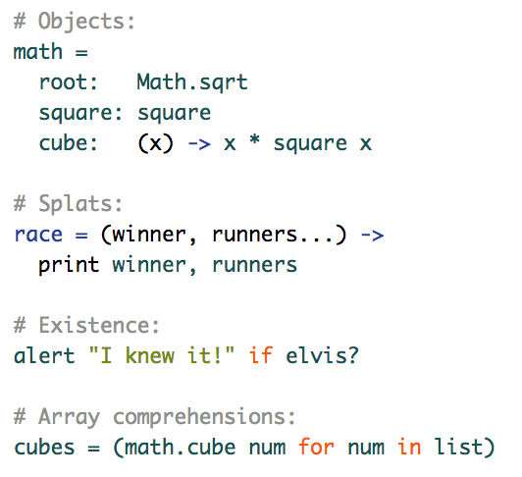

Slide 29
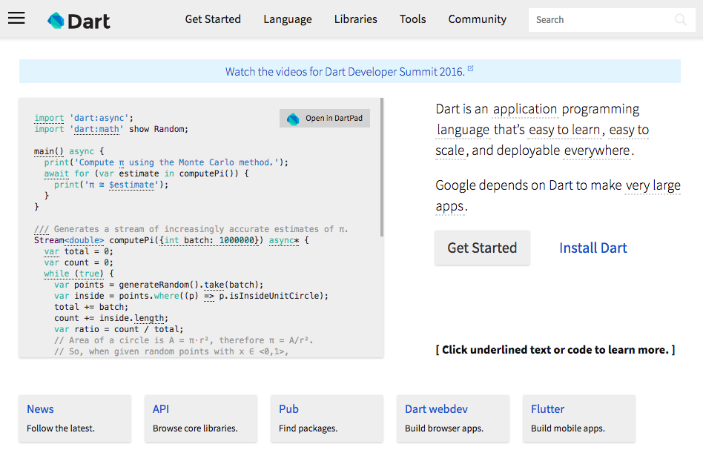
Notes:
2011

Slide 30
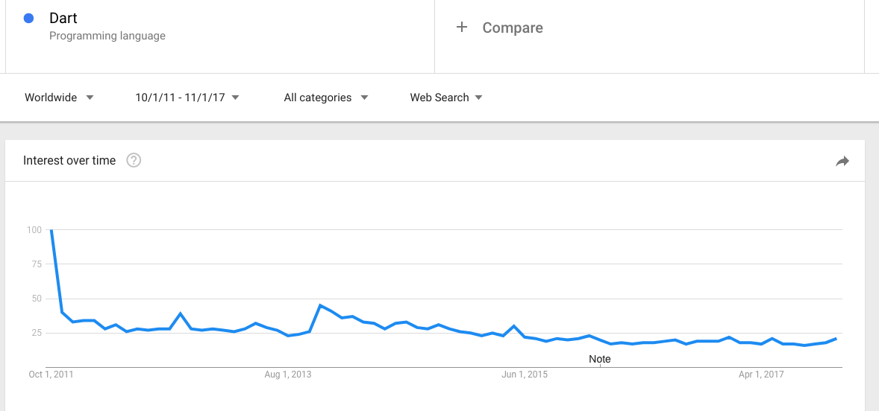

Slide 31
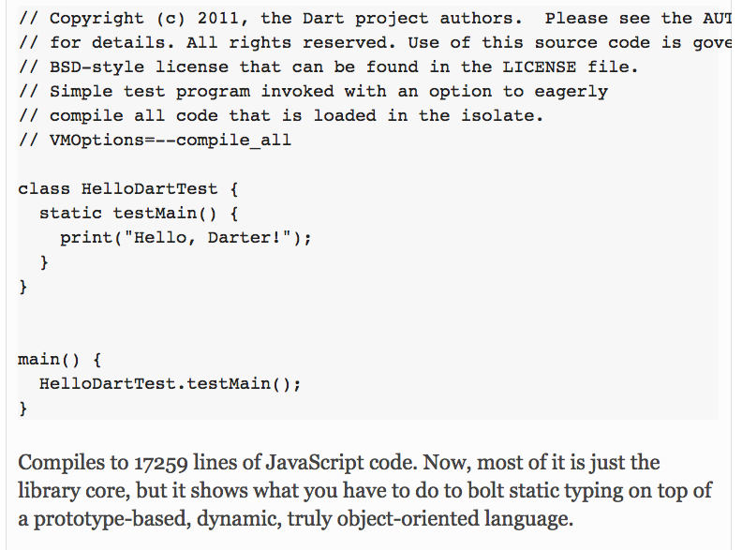

Slide 33


Slide 34
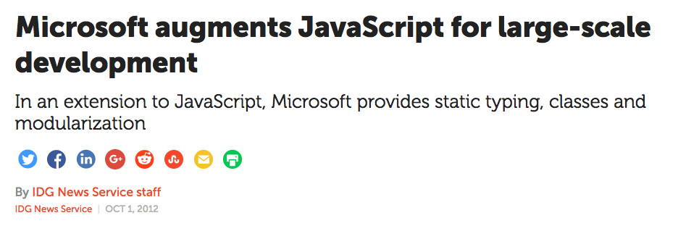
Notes:
October 2012

Slide 35
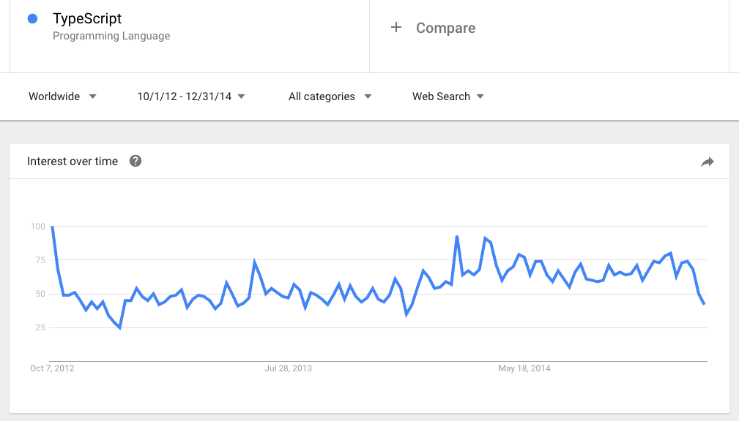

Slide 36
Why I Was Wrong About TypeScript

Slide 38


Slide 40


Slide 41


Slide 42
✉️

Slide 43
“We risk a lot by building our core on top of TypeScript.”

Slide 44
“I don’t hear anyone talking about TypeScript.”

Slide 45
“I like to keep my JavaScript pure, as God intended.”

Slide 46
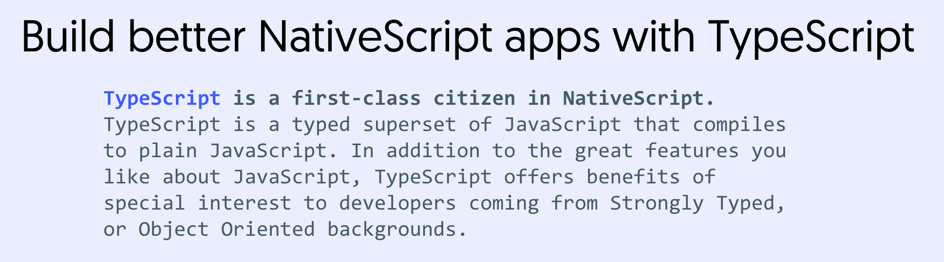

Slide 47
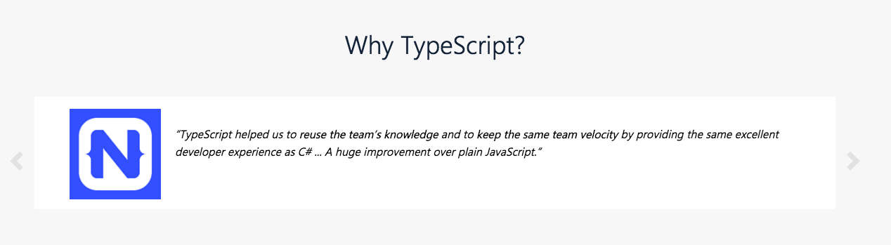

Slide 48
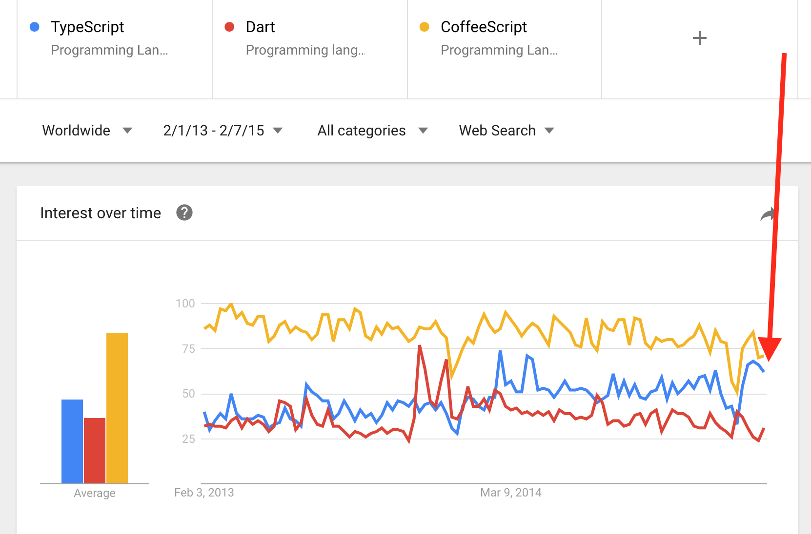

Slide 49
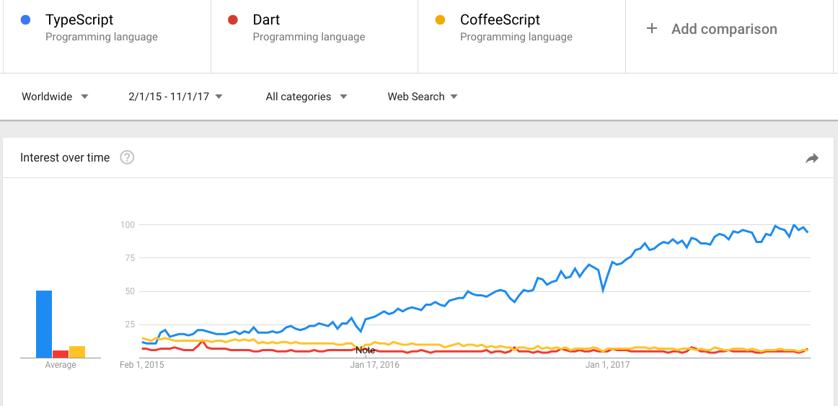

Slide 50
Why I Was Wrong About TypeScript

Slide 51
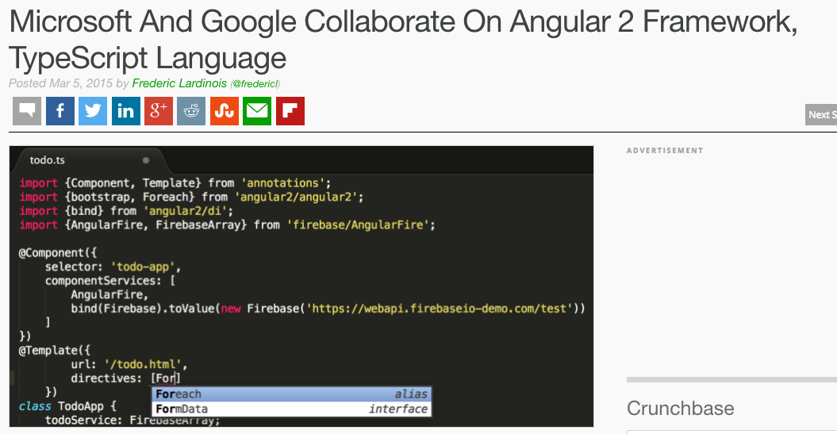

Slide 52
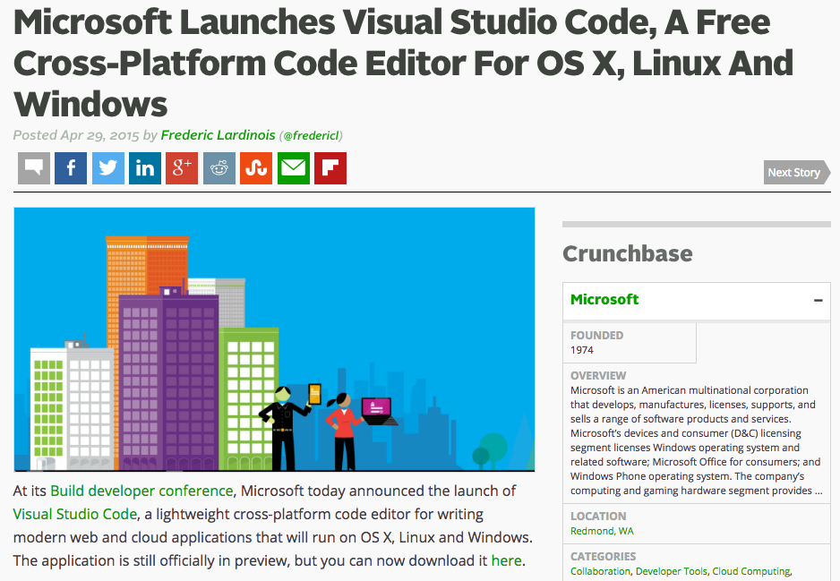

Slide 53
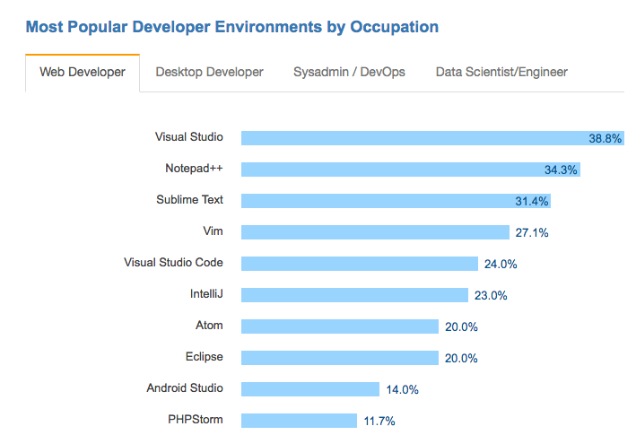

Slide 54
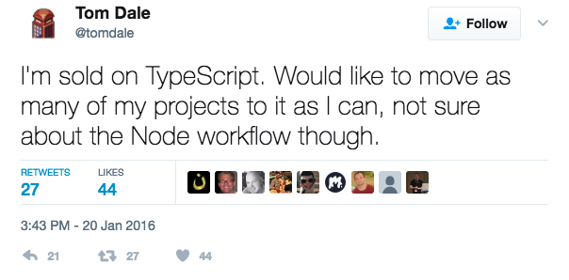

Slide 55
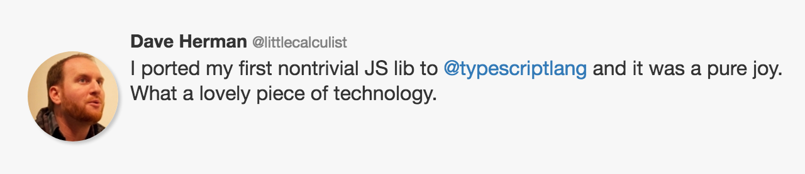

Slide 56
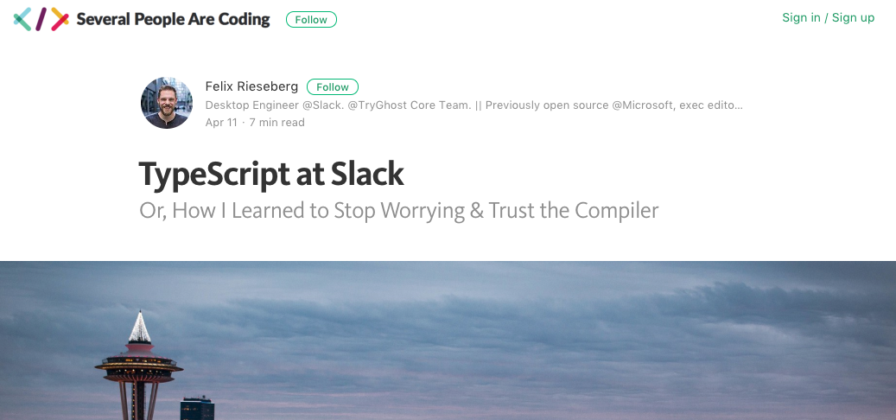

Slide 57
Why?

Slide 58
3 reasons

Slide 59
1) Commitment to the ECMAScript standard

Slide 60
“Some examples [of compile-to-JavaScript frameworks], like Dart, portend that JavaScript has fundamental flaws and to support these scenarios requires a “clean break” from JavaScript in both syntax and runtime. We disagree with this point of view. We believe that with committee participant focus, the standards runtime can be expanded and the syntactic features necessary to support JavaScript at scale can be built upon the existing JavaScript standard.”

Slide 61
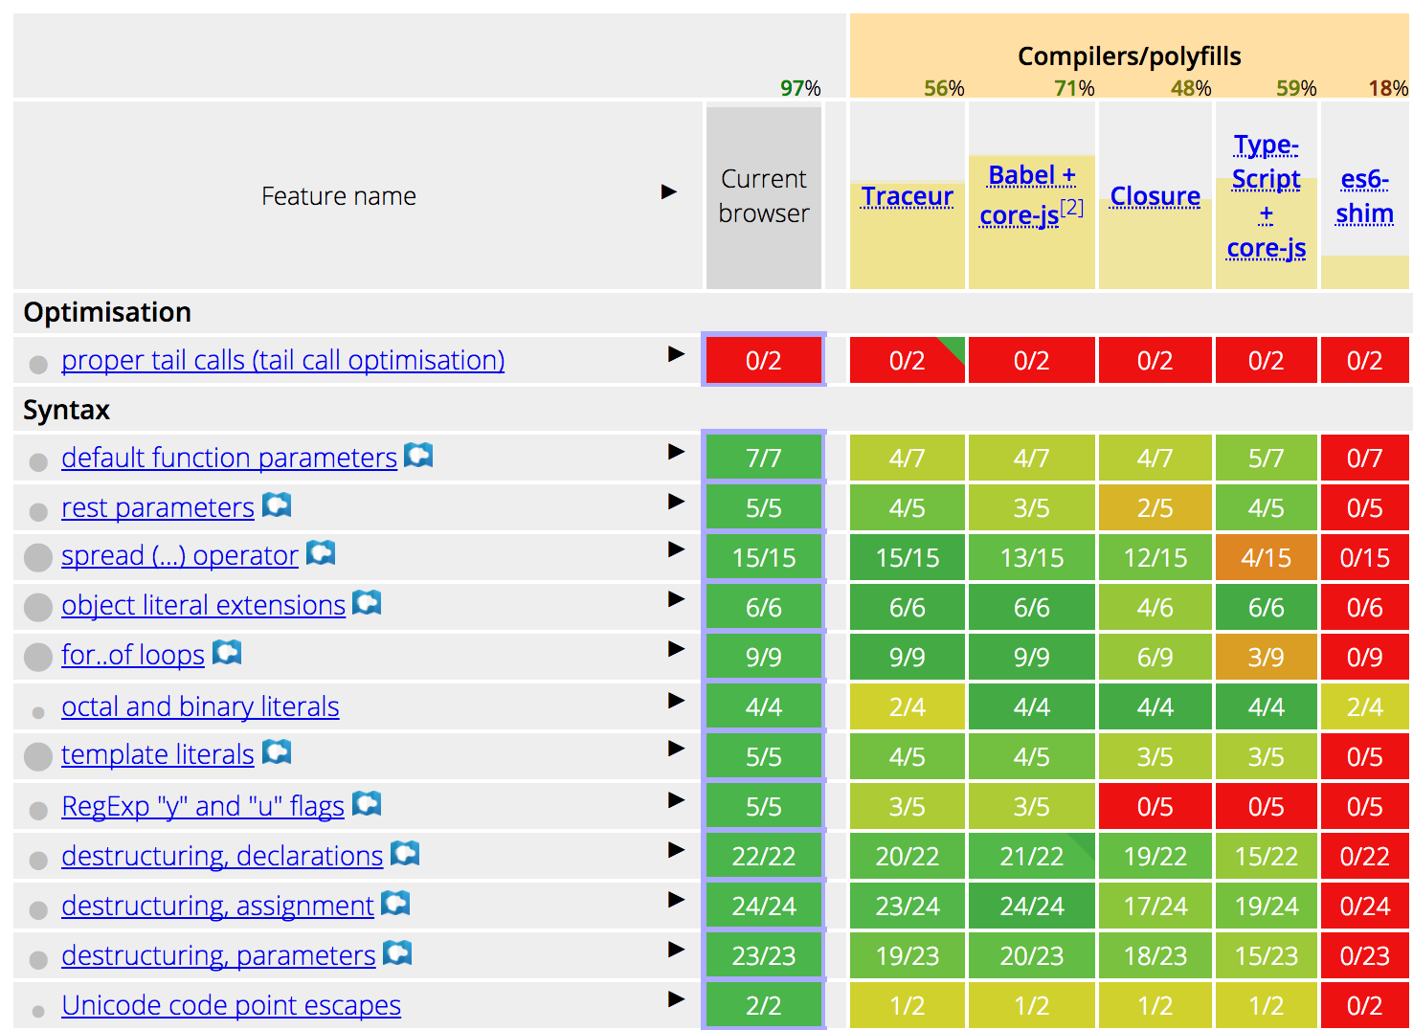

Slide 62
2) Types are opt-in

Slide 63
3) Tooling

Slide 64
So should you use TypeScript?
Are your apps big?
Do you work on a team?
Unfamiliar codebases?
Non JS developers that need to write JS code?

Slide 65
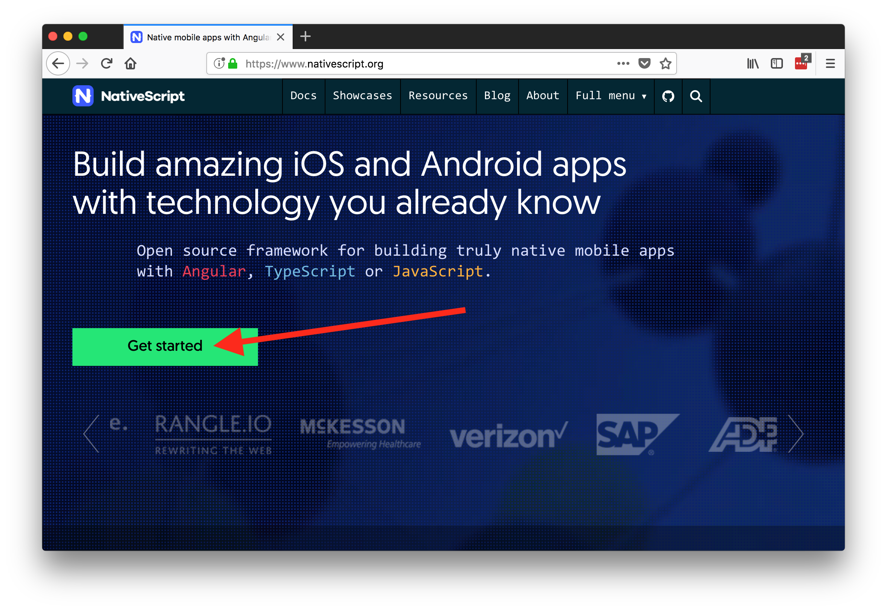

Slide 66
Thanks!
@tjvantoll

